Slide 1

Secure ERP
Customer Relationship Management
Human Resources
Sales

Slide 2
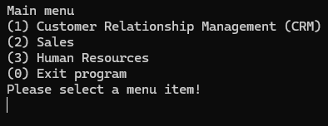
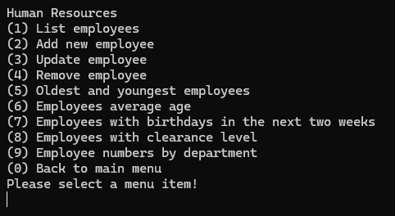
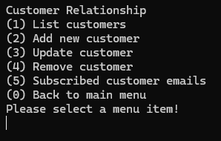
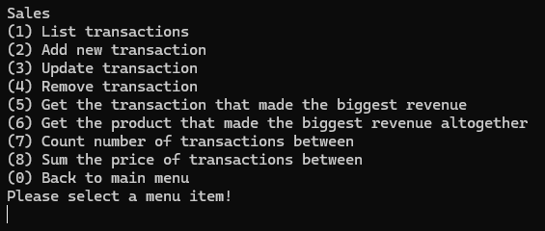
Starting the application
Main menu
HR menu
CRM menu
Sales menu

Slide 3
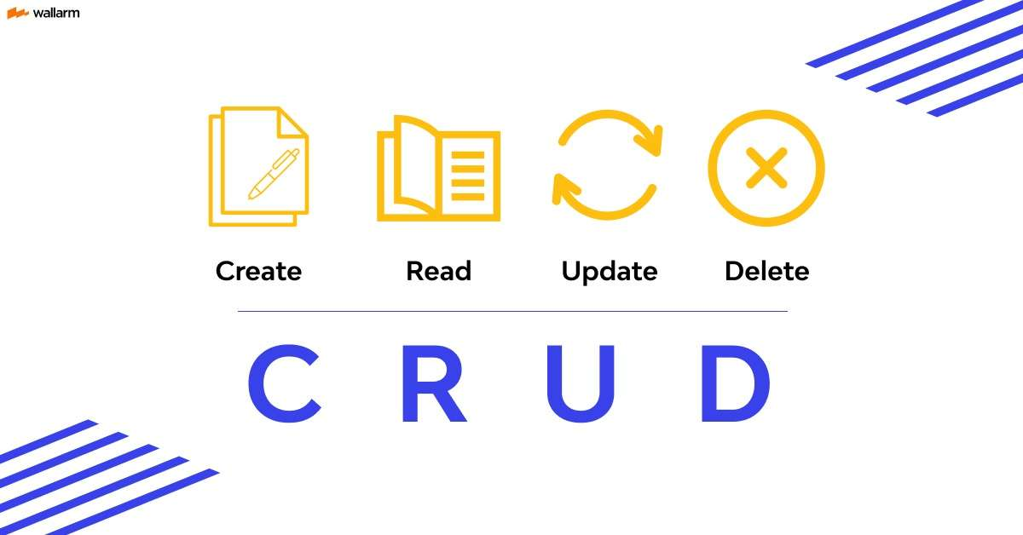

Slide 4
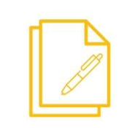


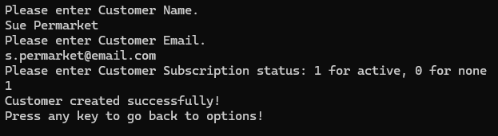
Adds new records (e.g., employee, product, or customer).
Data is entered line-by-line.
Controller validates input and the DAO stores it in the Database
Each new entry gets a unique ID for tracking and management.
CRM

Slide 5




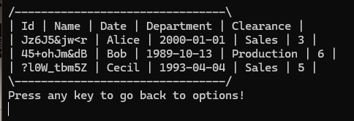
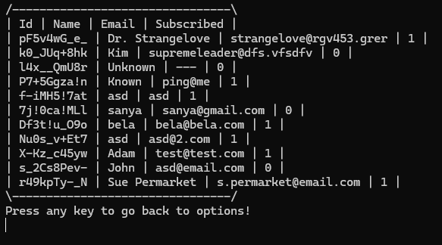
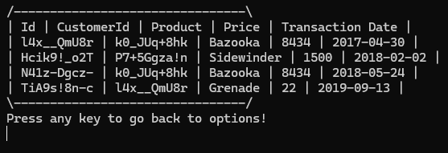
HR
Retrieves data from the local file using the DAO.
Controller sends the data to the view for display.
Supports viewing lists or single records (e.g., customer info).
Data is parsed and mapped into model objects.
Keeps the ERP system updated with the latest file data.
CRM
Sales

Slide 6


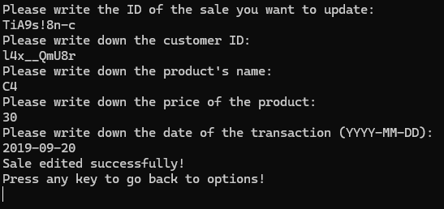

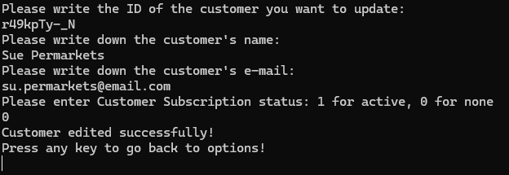
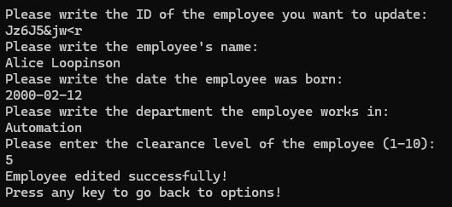
Sales
Edits existing records (e.g., changing Sue’s email).
Controller finds the target by ID and forwards the update.
DAO loads, modifies, and saves the updated record in the file.
Model ensures only valid fields are changed.
Ensures data accuracy without database use.
CRM
HR

Slide 7


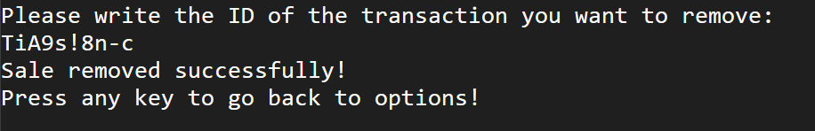
Removes a record (e.g., deleting Sue Permarket) by ID.
Controller passes the delete request to the DAO.
DAO finds and removes the record from the file.
File is then overwritten without the deleted data.
Safely clears custom entries from the ERP system.

Slide 8
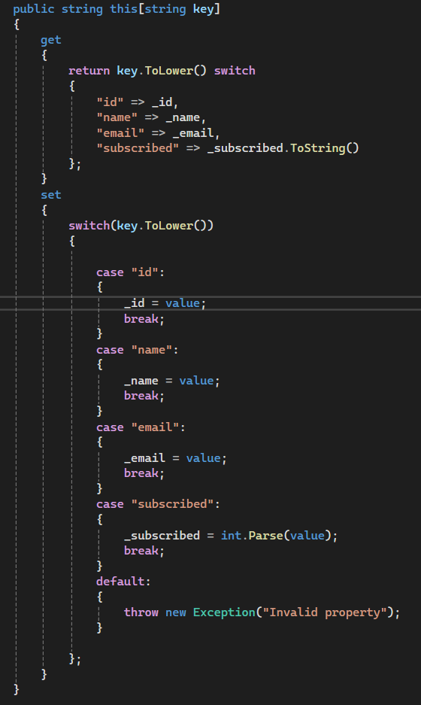
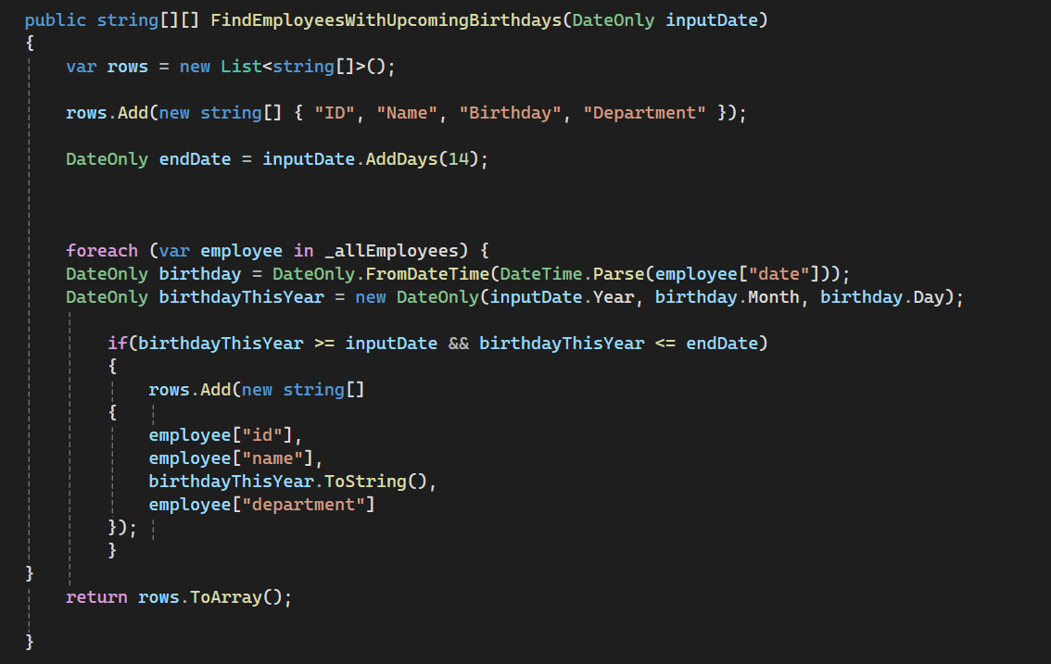
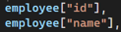
Other difficulties/points of interest
String indexing
Finding employees based on whether their birthday is in the next 14 days or not

Slide 9
Thank you for your attention!
Please feel free to ask any questions!
Created by: Zoli, Huni, Dani, Szabi

